Slide 1
Kilmaronock War Memorial
At the Old Kirk?

Slide 2
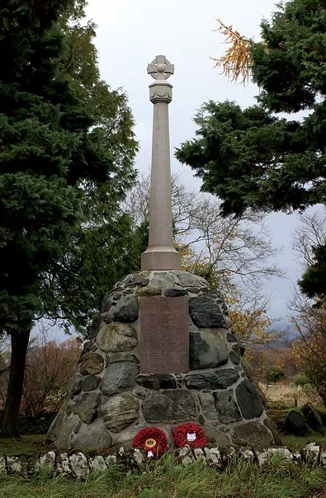

Slide 3
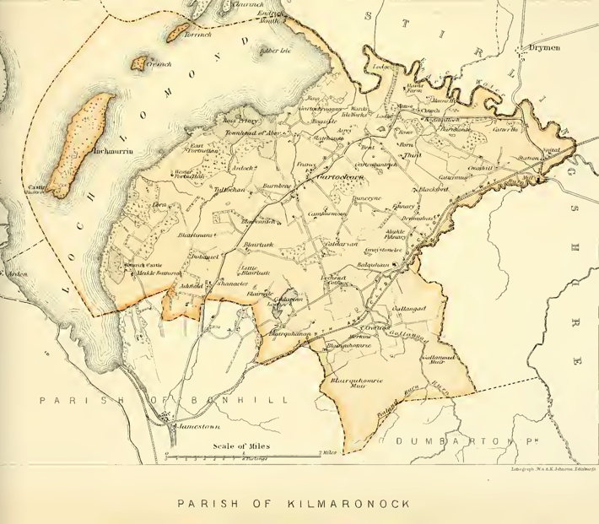
Parish of Kilmaronock

Slide 4
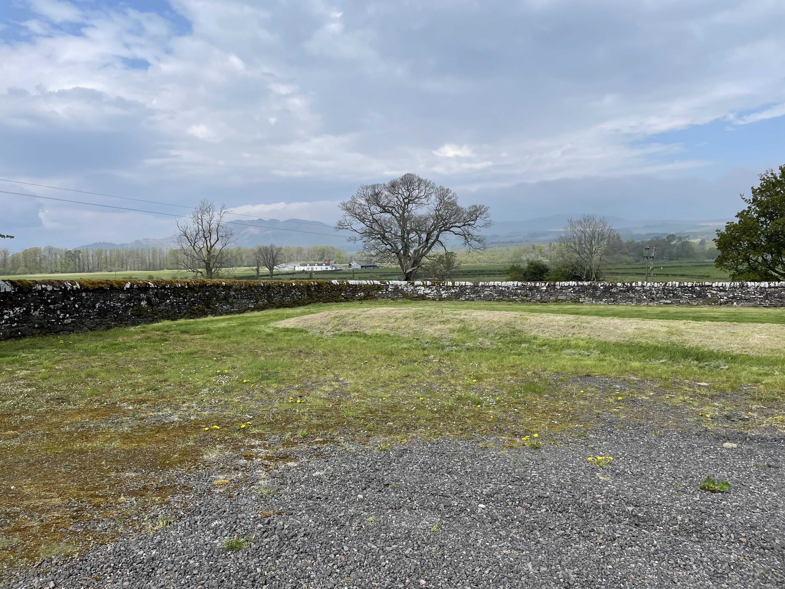
Locate at NW corner of the car park

Slide 5
Access to memorial at the Old Kirk
Trustees of the Kilmaronock Old Kirk Trust (KOKT) are all in support of the move to Kilmaronock and agree that I speak to KCC on their behalf
Parking in the car park or if locked park at Kirk and walk along path to car park
It is likely the ridge in the carpark will be moved in the next year or so
Area round memorial would be landscaped in this corner

Slide 6
Reason in favour of Old Kirk
Parish of Kilmaronock includes Croftamie and Gartocharn so memorial would be mid way between the villages
Good access car parking
In heritage site in community ownership beside Commonwealth War Graveyard
The Old Kirk will have a heritage display within the Kirk
Heritage tours are available at present and once the kirk is upgraded internally will be regularly open
Web site already exists

Slide 7
Unveiling of War Memorial

